Slide 1
CHAPTER 4 Optimal Predictive Control 7 Stability with infinite horizons and tail
Anthony Rossiter

Slide 2
Background on stability of MPC
It is clear from the numerous examples that the expected behaviour of GPC, and indeed closed-loop stability do not have a simple analytic link to the choice of the horizons.
Indeed, one can easily find examples of GPC where the control law gives closed-loop instability (poor behaviour).
The earlier chapter argued that long horizons helped to ensure a synergy between optimal predictions, desired behaviour and actual closed-loop behaviour; in turn this gives one an expectation, but not guarantee, of good closed-loop behaviour.
This chapter took this to extremes in that the performance index deployed infinite horizons and hence an obvious question is whether that enables better links to closed-loop behaviour and stability?

Slide 3
Summary for well-posed optimisations
A first requirement for expecting good a priori stability results is that the recursive decision making can be consistent from one sample to the next, otherwise chaos may ensue.
This requirement can be captured mathematically using the concept of the tail, that is the part of the previous optimal strategy yet to be implemented.
A well posed MPC algorithm should include the tail in the class of predictions over which the optimisation is performed at each sample.
GPC, OMPC and SOMPC all include the tail automatically and thus meet a fundamental requirement.

Slide 4
Sub-optimal dual mode MPC (SOMPC)
Take the dual-mode predictions based around the implementation of an arbitrary regulator and some perturbations.
Optimise predicted performance w.r.t. to the perturbations and implement the first value.
What can we say about the closed-loop stability of this approach?

Slide 5
The cost and infinite horizons
KEY ASSUMPTION
The cost is bounded/finite even though one is summing over an infinite horizon. This is because, by definition of the terminal feedback u=-Kx, both the predicted error and input converge to zero.
OMPC/SOMPC deploy infinite input and output horizons in the performance index.
A simple mechanism for investigating stability is to compare the solutions are subsequent samples and discern whether there is any useful pattern.
SISO case for simple algebra.
MIMO is equivalent.
We exclude the double subscript for now.

Slide 6
Comparing subsequent costs
Remember this is an upper bound for J_{k+1} as optimisation could make it even smaller.
OMPC/SOMPC include the tail, and therefore, for simplicity, let us assume that the optimisation at sample ‘k+1’ chooses the tail from the previous sample.
There is a very obvious and useful pattern that shows J must be a Lyapunov function, because:

Slide 7
Interim summary
In the worst case J_{k+1}=J_{k} and this requires that e_{k}=u_{k}=0 ; this can only happen repeatedly if one is at and remains at the target position!
If e_{k}≠0 and/or u_{k} ≠ 0 then J_{k+1}<J_{k,} so J is a Lyapunov function.
J comprises squares of errors terms, and therefore if J is monotonically decreasing, then the errors must also be converging to zero.
This is a simple but very powerful proof that applies to the nominal and constrained case. It is widely accepted in the community.

Slide 8
FOR COMPLETENESS CONSIDER FULLER NOTATION AND FINITE CONTROL HORIZONS
However, viewers should note that it is easy to extend/apply the generic presentation given so far to GPC with an infinite output horizon, OMPC, SOMPC and so on.

Slide 9
With infinite horizons, J is Lyapunov
Let the optimum predictions at k be
Now at k+1, inclusion of the tail implies one can select:
Next consider that the cost is defined as

Slide 10
With infinite horizons, J is Lyapunov
Now compare the cost at subsequent sampling instants, assuming one uses the tail. It should be clear that:
That is, J is always reducing unless (r=y) and Du=0. This can only happen repeatedly if one is already at the desired steady-state. Moreover, one can always re-optimise at each sample to make J even smaller still.

Slide 11
Proof applies during constraint handling
The only difference during constraint handling is that J is minimised subject to constraints.
If predictions at time k satisfy constraints, then so does the tail. Hence the tail can be used at k+1 and the Lyapunov property still holds.
There is however a need for feasibility, that is one must assume that there exists, at the outset, a prediction class which satisfies constraints.
Feasibility and constraints are topics for later chapters.

Slide 12
Proof applies with a finite input horizon (that is GPC) if the input terms beyond n_{u} are zero!
This is obvious by simply going through the steps of the proof but altering the costing horizon on the inputs to be nu.
All the steps of the proof are identical because restricting n_{u} simply adds lots of zeros for the far future control increments.
THE OUTPUT HORIZON MUST BE INFINITE IN GENERAL AS, EXCEPT FOR DEAD-BEAT RESPONSES, OUTPUTS ONLY CONVERGE ASYMPTOTICALLY.
One could equally argue that J is the same as one gets with an infinite input horizon anyway as in effect one has ‘added’ a constraint that certain values are 0!

Slide 13
Conclusions
Two conditions ensure that a predictive control law is guaranteed stabilising in the closed-loop.
Indeed one could also argue that these conditions to some extent ensure a well-posed optimisation and thus a good expectation of good closed-loop behaviour.
The prediction class must include the tail.
The input and output horizons in the performance index should be infinite (although the control horizon/number of d.o.f. need not be).
WARNING: Infinite output horizons can only be handled with open-loop unstable processes using a dual-mode approach.

Slide 14



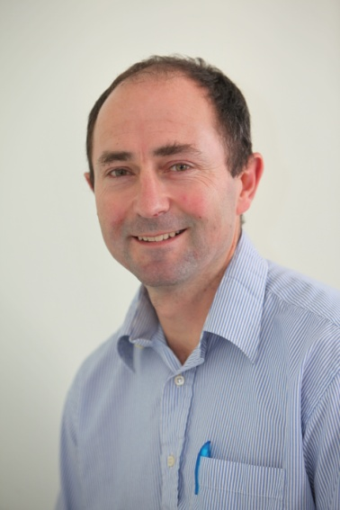
Anthony Rossiter
Department of Automatic Control and Systems Engineering
University of Sheffield
www.shef.ac.uk/acse
© 2014 University of Sheffield
This work is licensed under the Creative Commons Attribution 2.0 UK: England & Wales Licence. To view a copy of this licence, visit http://creativecommons.org/licenses/by/2.0/uk/ or send a letter to: Creative Commons, 171 Second Street, Suite 300, San Francisco, California 94105, USA.
It should be noted that some of the materials contained within this resource are subject to third party rights and any copyright notices must remain with these materials in the event of reuse or repurposing.
If there are third party images within the resource please do not remove or alter any of the copyright notices or website details shown below the image.
(Please list details of the third party rights contained within this work.
If you include your institutions logo on the cover please include reference to the fact that it is a trade mark and all copyright in that image is reserved.)

